Slide 1
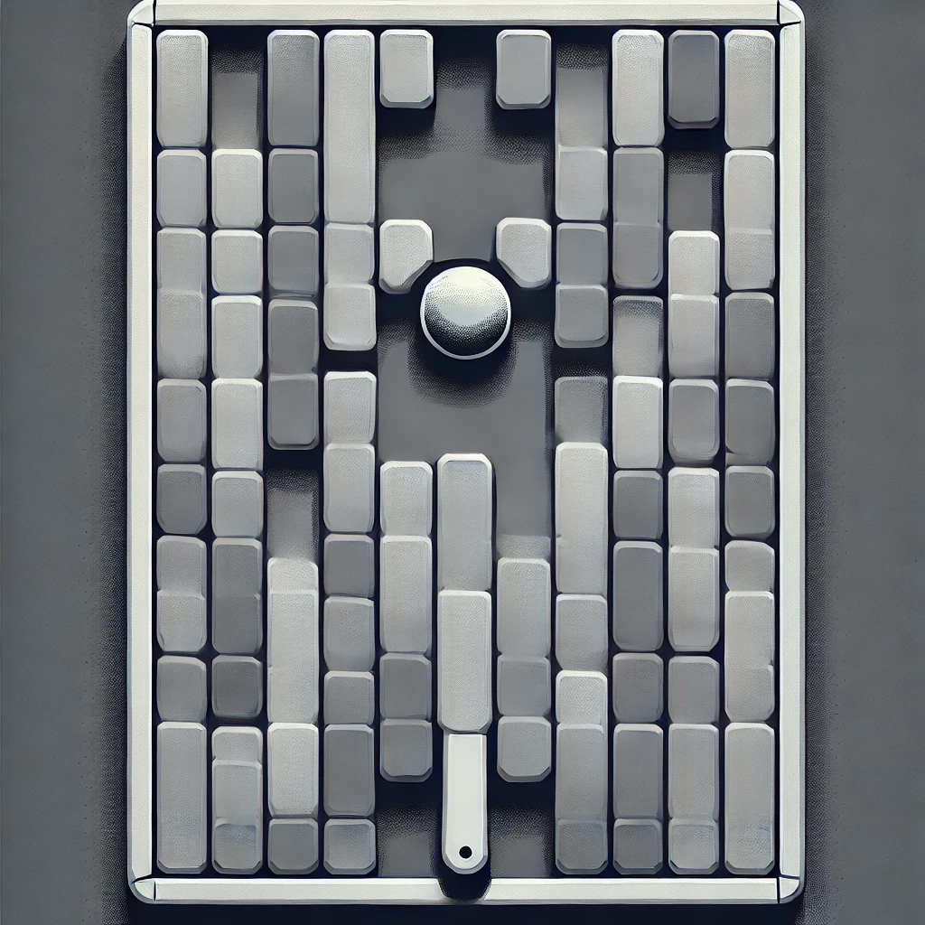
Brick Breaker Game using AWT
UNITED COLLEGE OF ENGINEERING AND REASERCH
NAINI, PRAYAGRAJ

Slide 2
TEAM MEMBERS
KARTIKEY JAISWAL (2300101530069)
SHRISHTI SONKAR (2300101530153)
SAMARTH BISHT (2300101530128)
PRIYANSHU SINGH (2300101530107)

Slide 3
Brick Breaker Game in AWT Java
The Brick Breaker game, developed using Java's Abstract Window Toolkit (AWT), is a classic arcade game where players control a paddle to bounce a ball and break bricks.
Objective :
Break All Bricks: The main goal is to break all the bricks on the screen by bouncing the ball off the paddle.
Control the Paddle: Use keyboard inputs to move the paddle left and right, ensuring the ball stays in play.
Score Points: Earn points for each brick broken, aiming for the highest possible score.

Slide 4
Introduction to AWT
The Abstract Window Toolkit (AWT) is Java's original platform-dependent windowing, graphics, and user-interface toolkit. It provides a set of APIs to create graphical user interfaces (GUIs) for Java programs. AWT components are heavyweight, meaning they rely on the underlying native windowing system, ensuring platform-specific look and feel.
Basic Components of AWT Frame:
Canvas: A blank rectangular area where graphics can be drawn.
Panel: A container for organizing components.
Button: A component that triggers an action when clicked.
Label: A non-editable text component.
TextField: A component for single-line text input.
Event Handling: Mechanism to respond to user inputs like keyboard and mouse actions.

Slide 5
Differences between AWT and other GUI frameworks like Swing
AWT (abstract window toolkit)
SWING
Platform-Dependent: Uses native code for rendering, ensuring a native look and feel.
Heavyweight Components: Relies on the operating system's windowing system.
Basic Functionality: Limited set of components and capabilities.
Platform-Independent: Pure Java implementation, providing a consistent look and feel across platforms.
Lightweight Components: Built on AWT but does not rely on native code for rendering.
Rich Functionality: More sophisticated components and extensive customization options.

Slide 6
Game Design and Architecture
Game Layout
Paddle: Positioned at the bottom, controlled by the player to bounce the ball.
Ball: Moves around the screen, bouncing off walls, the paddle, and bricks.
Bricks: Arranged in rows at the top, break upon collision with the ball.
Main Game Loop and Its Components
Initialization: Set up the game window, create game objects (paddle, ball, bricks), and initialize game state.
Event Handling: Capture and process user inputs (e.g., moving the paddle).
Update: Update the positions and states of game objects based on game logic.
Render: Draw the updated game state onto the screen.
Sleep: Control the frame rate to ensure smooth gameplay.

Slide 7
Setting Up the Environment
Required Tools
Java Development Kit (JDK)
Essential for compiling and running Java applications.
Includes the Java Runtime Environment (JRE), Java compiler (javac), and other development tools.
Download from the Oracle JDK website or use an open-source alternative like OpenJDK.
Integrated Development Environment (IDE)
IntelliJ IDEA: Popular for its powerful features and ease of use.
Eclipse: Highly customizable with a large ecosystem of plugins.
NetBeans: Integrated with many Java tools, ideal for Java development.
Choose an IDE that fits your preferences and workflow.

Slide 8
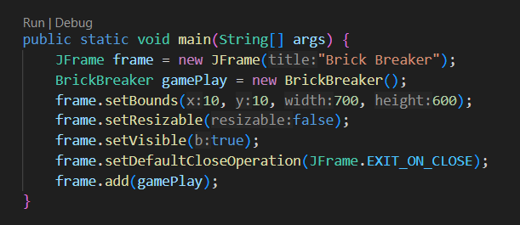
Creating the Game Window
Jframe Setup:
setTitle("Brick Breaker"): Sets the window title.
setSize(800, 600): Defines window dimensions.
setResizable(false): Prevents window resizing.
setLocationRelativeTo(null): Centers the window on the screen.

Slide 9
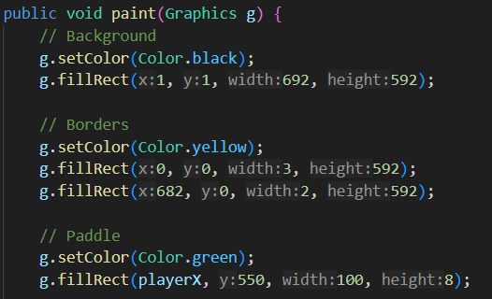
Implementing the Paddle
Attributes:
x, y: Position of the paddle.
width, height: Dimensions of the paddle.
speed: Movement speed of the paddle
Movement Handling: You can add key listeners to move the paddle left or right when specific keys are pressed.

Slide 10
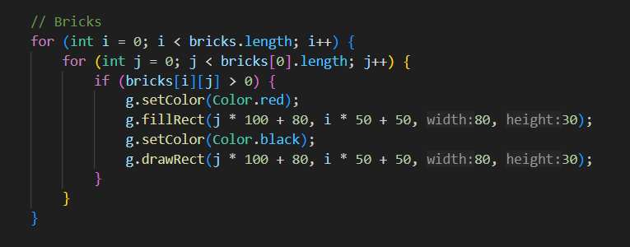
Implementing the Bricks
Attributes:
x, y: Position of the brick.
width, height: Dimensions of the brick.
isVisible: Whether the brick is visible (not destroyed).
Arranging Bricks: we use a 2D array or a list to arrange bricks in rows and columns.

Slide 11
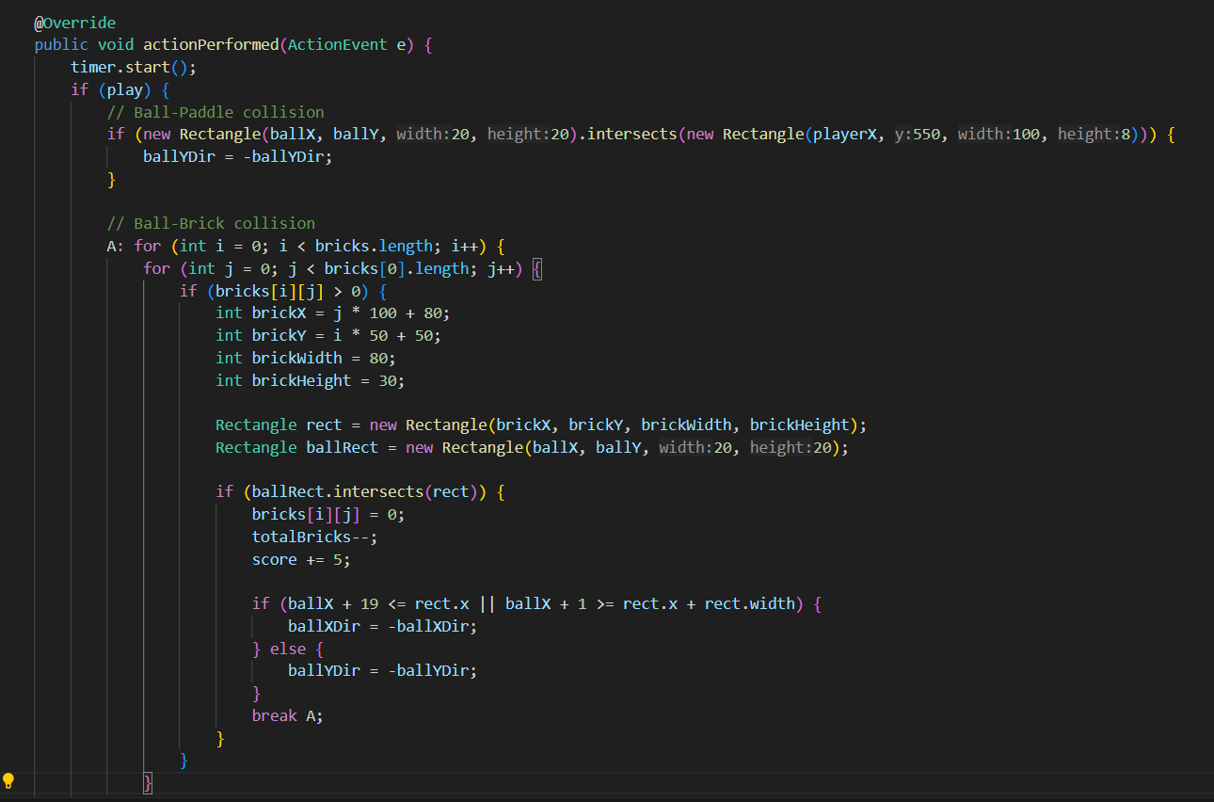
Collision Detection
Ball and Paddle Collision: Reflect the ball when it hits the paddle.
Ball and Brick Collision: Change brick visibility (or remove), and reflect the ball.
Updating Game State:
Handle Paddle Movement: Adjust paddle position based on user input.
Ball Movement: Update the ball's position and direction based on collisions.
Remove or Hide Bricks: Adjust visibility of bricks when hit by the ball.

Slide 12
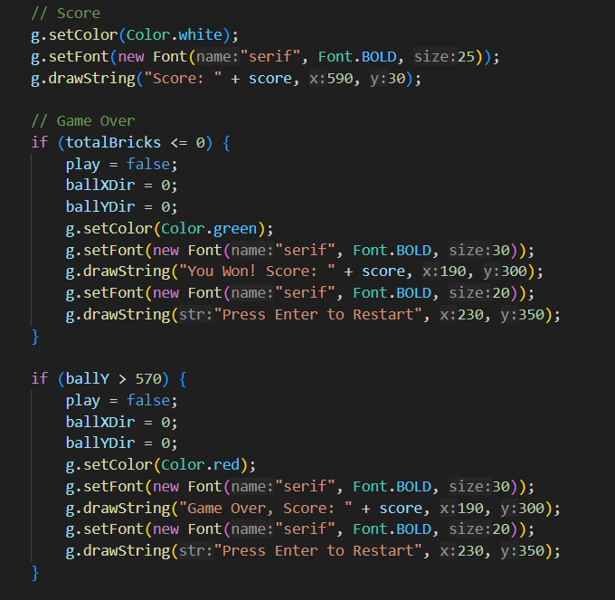
Adding Game Over and Victory Conditions
Game Over Conditions:
Ball Falls Below Paddle: If the ball falls below the paddle, the game is over.
Victory Conditions:
All Bricks Destroyed: If there are no more visible bricks, the player wins.

Slide 13
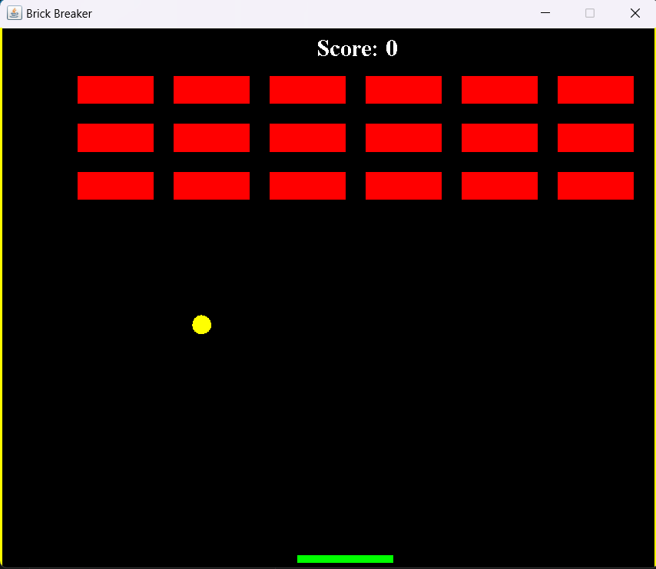
Output Of the program

Slide 14
Conclusion
Overall, this project was a valuable experience in applying Java and AWT to create a functional and entertaining game. It provided practical insights into game development, from designing the interface and handling user interactions to implementing game logic and ensuring smooth performance. The skills and knowledge gained from this project lay a solid foundation for further exploration and development of more complex applications and games.

Slide 15

Game Demo
Here is the demo of the game which we made as our project

Slide 16
THANKYOU

